Slide 1
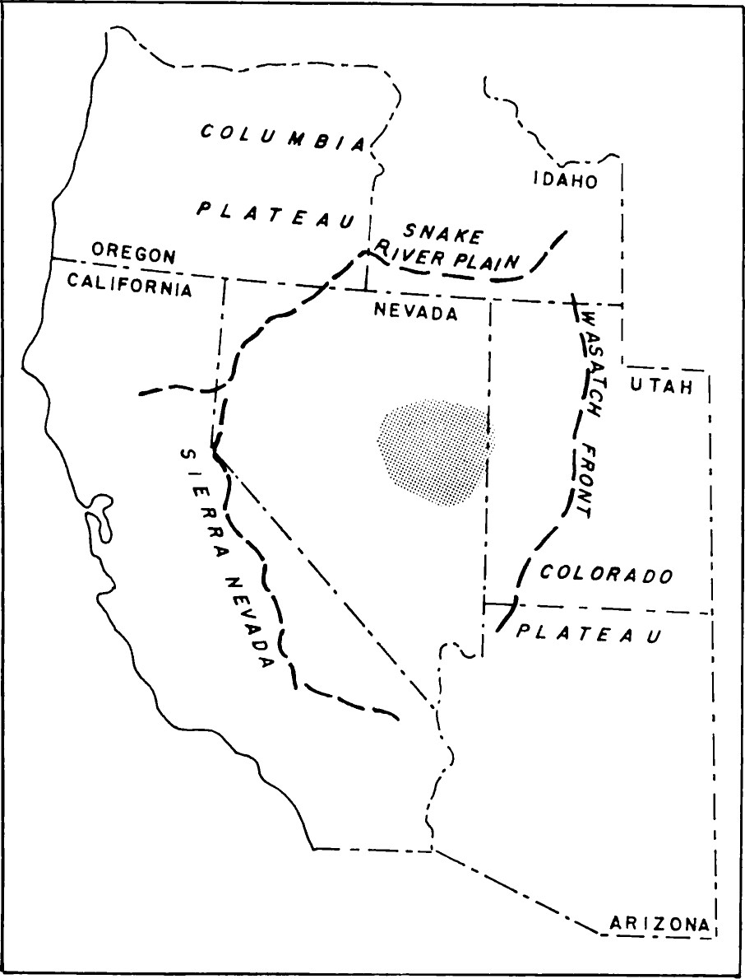
Space-Time Relations of Cenozoic Silicic Volcanism in the Great Basin of the Western United States
Richard L. Armstrong, E. B. Ekren, Edwin H. McKee, and Donald C. Noble
Presentation by Angie
Notes:
This paper summarizes and discusses data that shows silicic Cenozoic volcanism migrates outwardly from the east central Nevada core

Slide 2
Motivation
Previous work shows distinct distribution and possible migration of silicic volcanism.
However, none prove a systematic shift and cessation of silicic volcanism.
Schilling, 1965
Cook, 1965
Notes:
BLUE-Cook: mapping in east central Nevada show young volcanics trending towards south and east into SE NV and SW Utah
ORANGE-USGS: mapping in south central Nevada show almost all southern Nevada rocks are <15my
GREEN-Schilling: recognized rocks become younger to the southwest and west margins
YELLOW-Others: large volumes of silicic pyroclasts and lavas of Miocene and Pliocene age.
All data are compatible, but none prove systematic northward shift in the locus and cessation of silicic volcanism

Slide 3
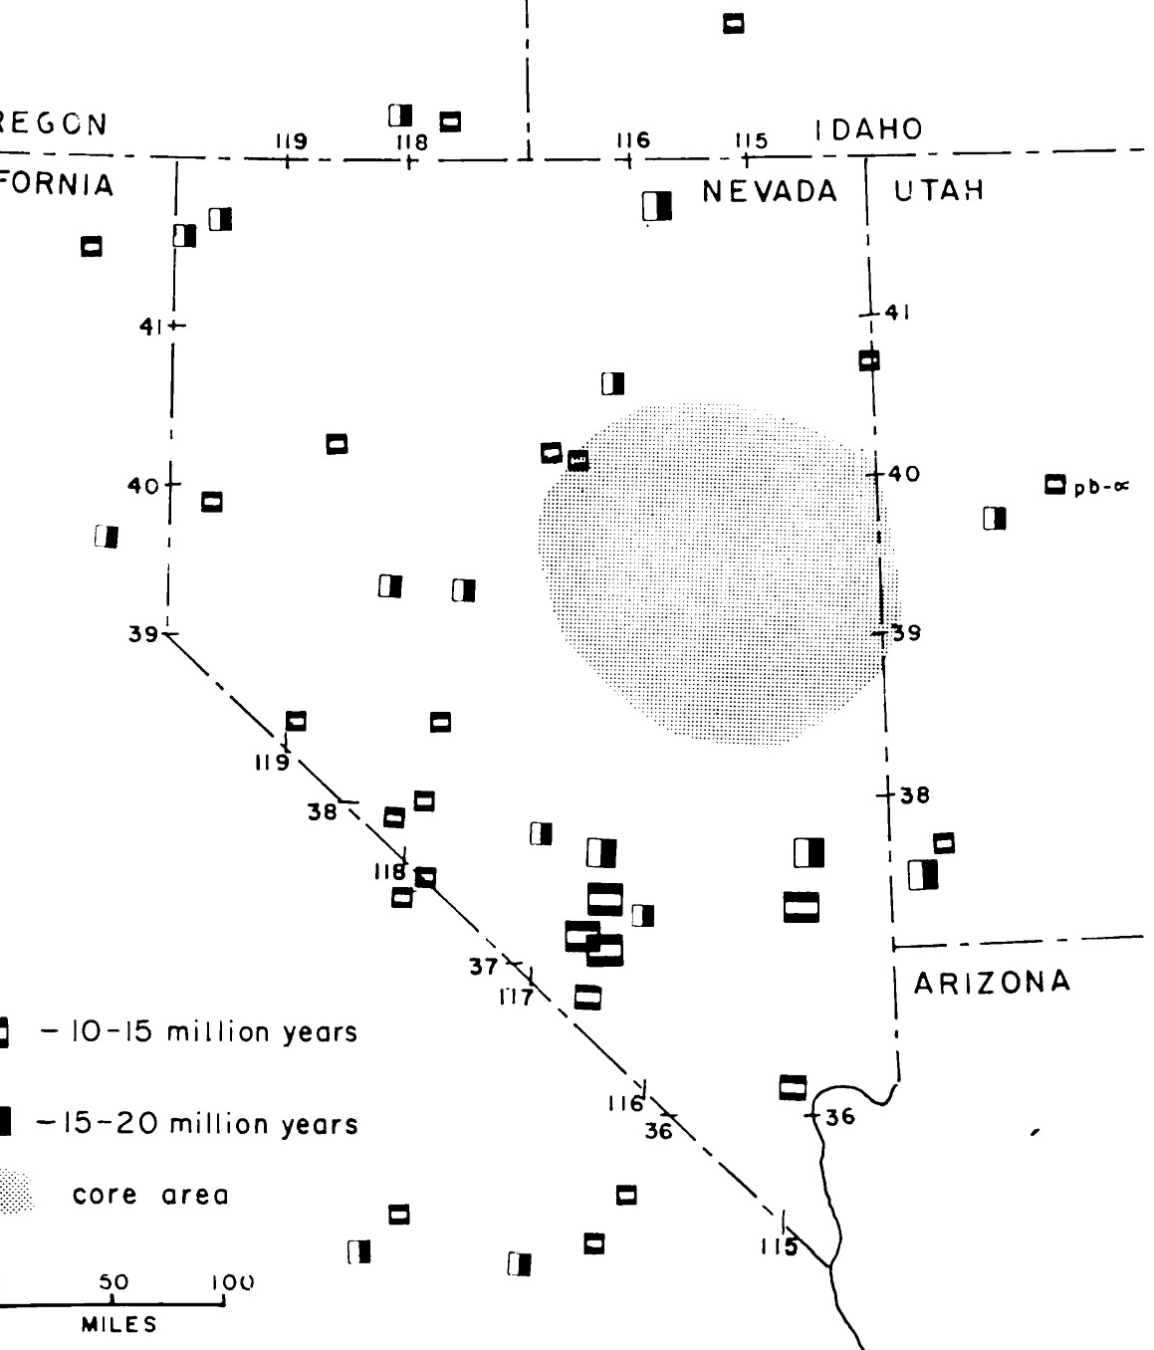
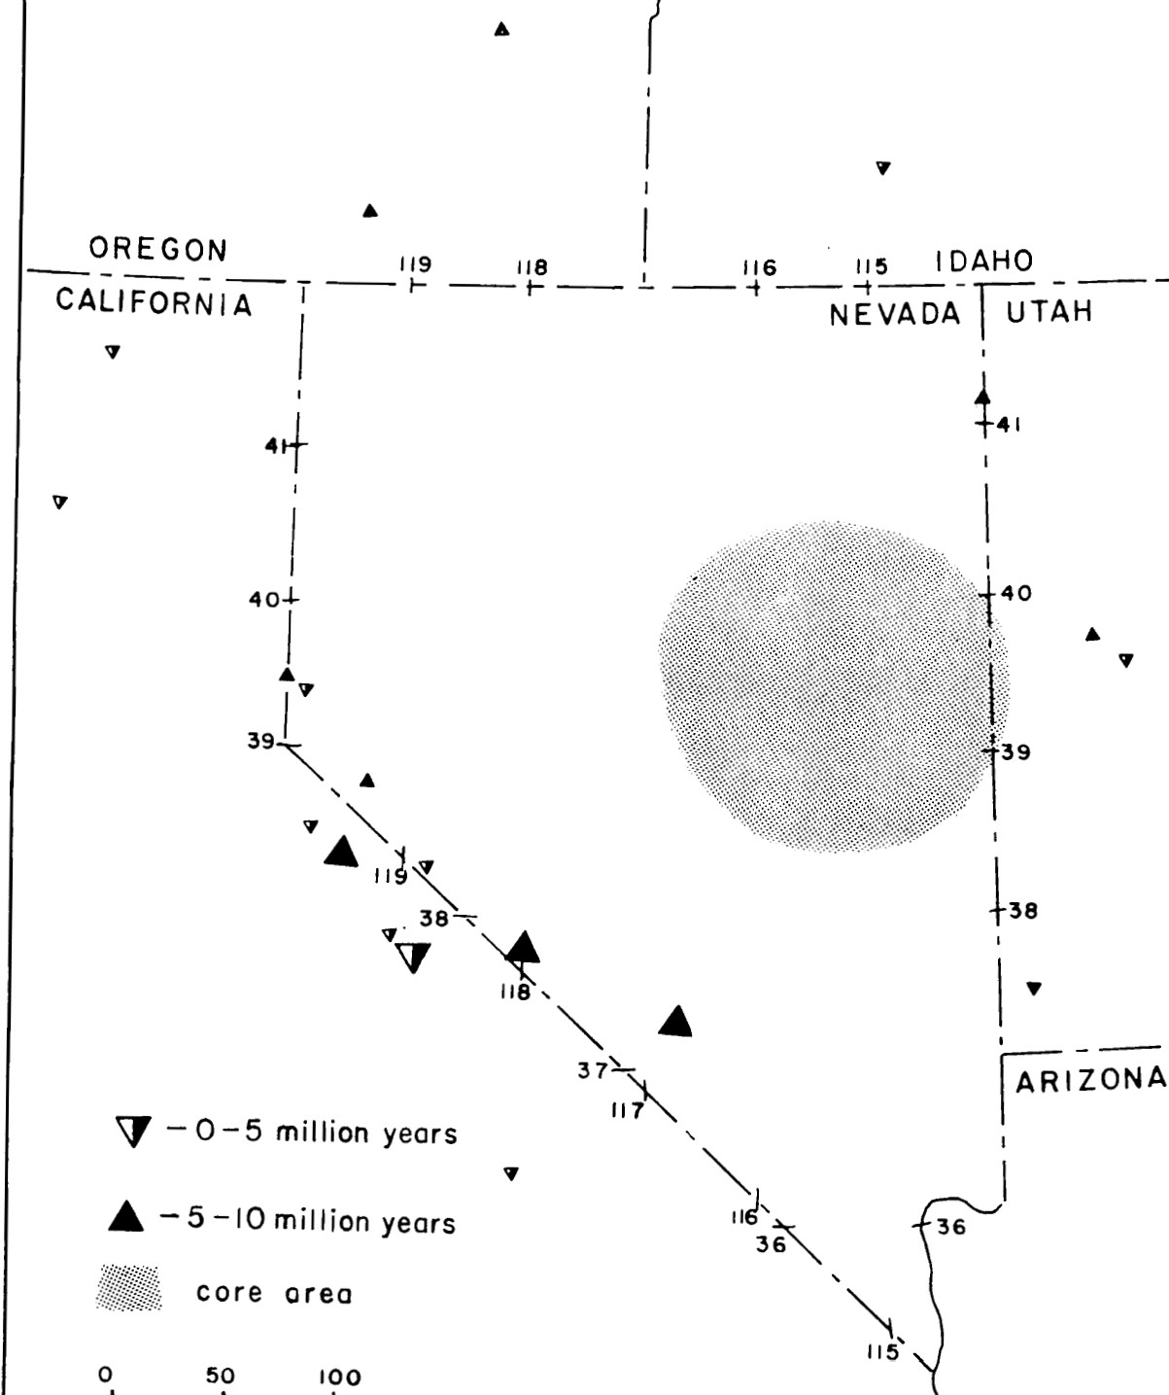
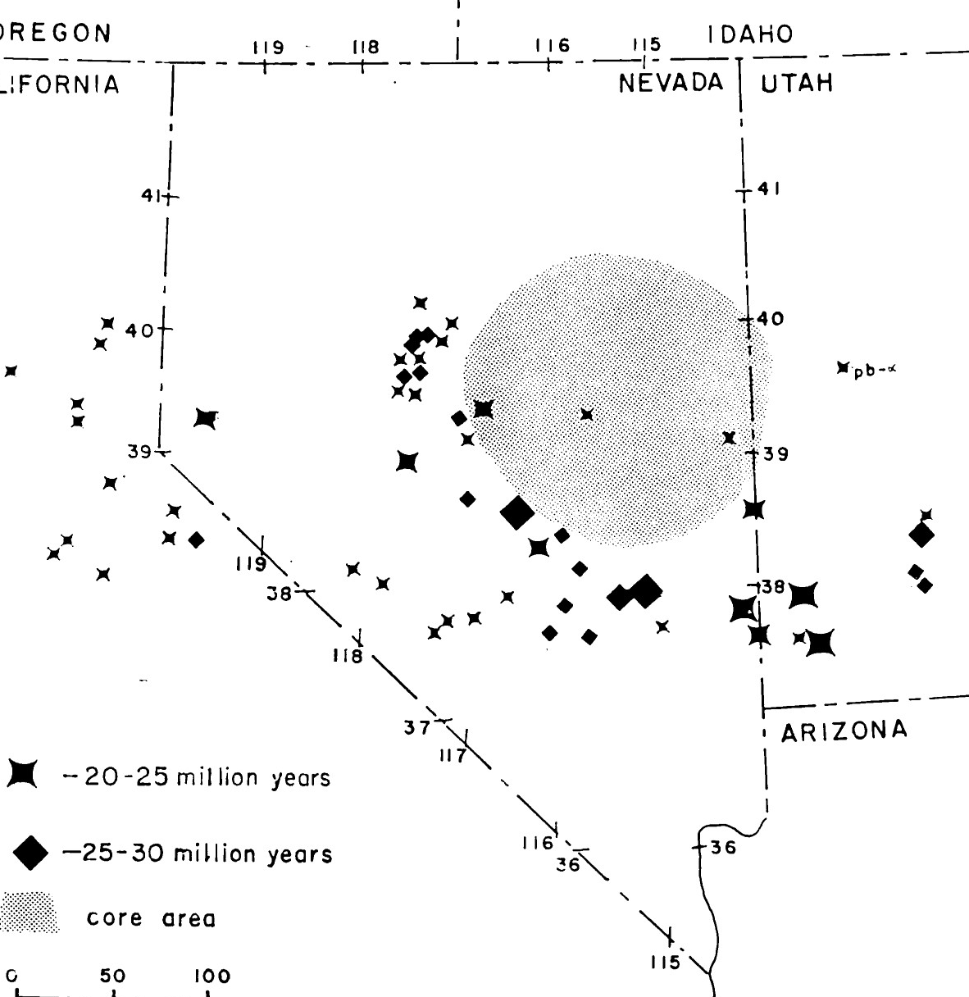
Silicic Volcanism Distribution
>30m.y.
10-20m.y.
<10m.y.
Key Finding: FEW <20 my units in the East- Central core, and FEW units <10 my in the entire state.
20-30m.y.
Notes:
COMBINED over 250 K-Ar ages from this study, McKee, and USGS

Slide 4
Volcanic History
Silicic volcanism began in the east central Nevada core (>30my)
Silicic volcanism ceases in core (25-30my) and spreads South, West, and North
No progression of volcanism to the east
Mafic units overlie silicic units in the core and southeast (30-35my)
Volume of silicic rocks decreases with age, indicates intensity of volcanism is decreasing
Notes:
No progression of volcanism to the east- both young and old units on the Wasatch front
Mafic units are thought to be erupted within 5 my of end of silicic volcanism

Slide 5
Tectonic Significance
Much of the unique basin and range topography is related to Cenozoic volcanism
Outward migration of volcanism is paralleled with extensional normal faults
How did volcanism begin? Extension below the continent of the East Pacific Rise (MOR), rogue convection currents triggering mantle material diapirs?
Notes:
Cenozoic volcanism: for example the east central Nevada core is seismically inactive, and thicker than the rest of the B&R.
Normal faults: Many normal faults post date silicic volcanic activity
Mor- causing upwelling of the crust
Mantle disturbance- this would explain why there are caldera collapse style features in the B&R

Slide 6
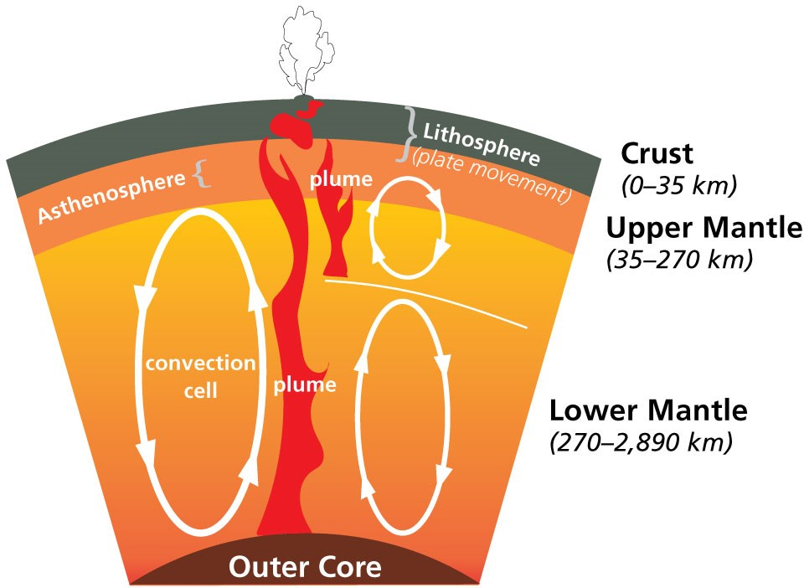
Tectonic Model
In the mantle, a rising convection current caused deformation in the crust above forming deep reaching fractures that reached down to the lower crust causing partial melting of hot material (from Mesozoic orogenies).
Due to the elevated temperature of the crust at depth from Mesozoic orogeny metamorphism there were deep magma sources, fractures kept growing to tap deeper sources.
NPS, Yellowstone
Notes:
Mesozoic orogenies caused the medium and high grade metamorphic Paleozoic rocks

Slide 7
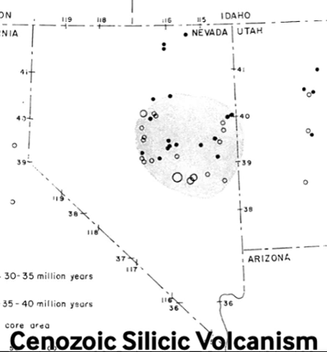
Conclusions
Outward shift of volcanism and extension beginning at 30 my originating from the east central Nevada core, which is also where the highest grade Mesozoic metamorphism occured.
An abrupt end of silicic volcanism at 25-30 my represents exhaustion of magma sources.

